Slide 1
Summary
Studyforrest_dFC

Slide 2
Data description
Data were collected from the studyforrest project (studyforrest.org)
15 Participants were scanned using MRI while watching the entirety of the movie Forrest Gump
fMRI activity were collected across the whole movie in 8 runs, in intervals (i.e. TRs) of 2 seconds

Slide 3
Question and Aim
Does the pattern of connectivity between different brain regions, or the simple pattern of neural activity of brain regions, be better representative of movie scenes?
Connectivity measures how related patterns of activities are, not the magnitude of activity per se.
To do so, I compared the classification accuracy of movie scenes between dynamic functional connectivity (dFC) and the pattern of BOLD activity across all Regions-Of-Interest (ROIs).

Slide 4
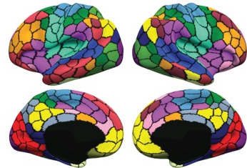
ROI delineation
The human brain divided (black lines) into 419 regions-of-interest (ROI). Figure adapted from Schaefer2018.
The neural activity within each ROI changes across time, and can be measured using fMRI.
Functional Connectivity (FC) correlates the activity of each ROI across time in a pairwise fashion with remaining ROIs, resulting in a 87,571 (lower-half of a 419-by-419 correlation matrix) unique correlations.

Slide 5
Preprocessing
Both structural and functional data were projected into surface space using recon-all (Freesurfer 5.3.0), and functional data were preprocessed utilising the CBIG pipeline.
dFC was calculated by taking a window of activity divided equally around the time point (TR) of interest, and then correlating the activity in this window amongst the 419 ROIs as delineated in Schaefer2018.
ROI activity was simply the amplitude of the BOLD signal for each of the 419 ROIs at the corresponding timepoint (i.e. TR) of interest.

Slide 6
Overview of comparison flow
dFCs vectorised by TR (2,956-by-87,517)
PCA
(2,956-by-10)
Train/test split
(80% train)
SMOTE (Train)
XGBoost (Train)
Test
(20% test)
ROI Timeseries by TR
(2,956-by-419)
Data were transformed/normalised and averaged across subjects.

Slide 7
dFC data preperation
Generated dFCs using a 55 TR (110s) window, and averaged across subjects (total 3,167 TRs across 8 runs)
Vectorised dFCs per TR into rows (i.e. created matrix of 3,167 rows by 87,571 columns)
Labelled each dFC window with the scene according to the timestamp.
Dropped rows according to the criteria below, resulting in a 2,956-by-87,571 matrix (87,572 with labels):
Scenes that were not consistent across the TR
Scenes occurred less than 10 TRs in total across all runs
Performed PCA on the 2,956-by-87,571 matrix (excluding labels), selected the first 10 PCs
10 PCs were selected based on repeated testing of varying number of PCs, to find the least number of PCs where accuracy and F1 scores stabilised.
Final Feature matrix: 2,956 vectorised dFC windows by 10 PCs
Target vector: 2,956 scene labels
Notes:
Synthetic Minority Over-sampling Technique

Slide 8
Selection of 10 PCs

Slide 9
ROI activity data preparation
Generated averaged (standardised) timeseries of each ROI by TR across subjects (total 3,167 TRs across 8 runs)
Labelled data similarly to the dFC matrix, but DID NOT perform PCA.
Final Feature matrix: 2,956 dFC windows by 419 ROIs
Target vector: 2,956 scene labels
Notes:
Synthetic Minority Over-sampling Technique

Slide 10
Common workflow
Features were randomly split into 80% train and 20% test matrices, stratified by target vector.
Synthetic data for minority classes in the Training dataset were generated using SMOTE (k neighbours = 5)
Model was trained using XGBoost, and tested on the remaining 20%.
Classification accuracy, precision and recall scores were measured.
This train/test workflow was repeated 50 times.

Slide 11
Results
Notes:
Macro: Calculate metrics for each label, and find their unweighted mean. This does not take label imbalance into account.
Accuracy = (TP + TN) / Total
Precision = TP / (TP + FP)
Recall = TP / (TP + FN)

Slide 12
PC plots
For each PC, the weights of each ROI-to-ROI connection are plotted as a 419-by-419 heatmap, with each ROI further grouped into 9 networks.
The subsequent plots are thresholded to show the top 10%, in terms of absolute weight, of the importance of each connection between ROIs towards each PC.
Figures were plotted in MATLAB 2018a according to the Schaefer2018 parcellation, but importantly represent PC weights and not the original intended purpose of correlation strengths.

Slide 13
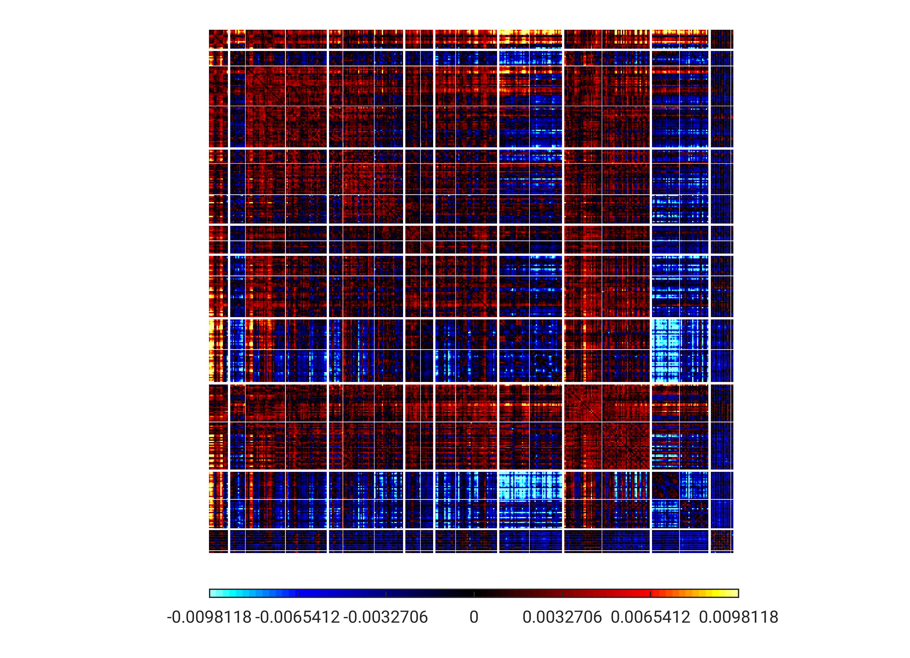
PC1 - unthresholded
TempPar
Default
Control
Limbic
Sal/VentAttn
DorsAttn
SomMot
Visual
Subcort

Slide 14
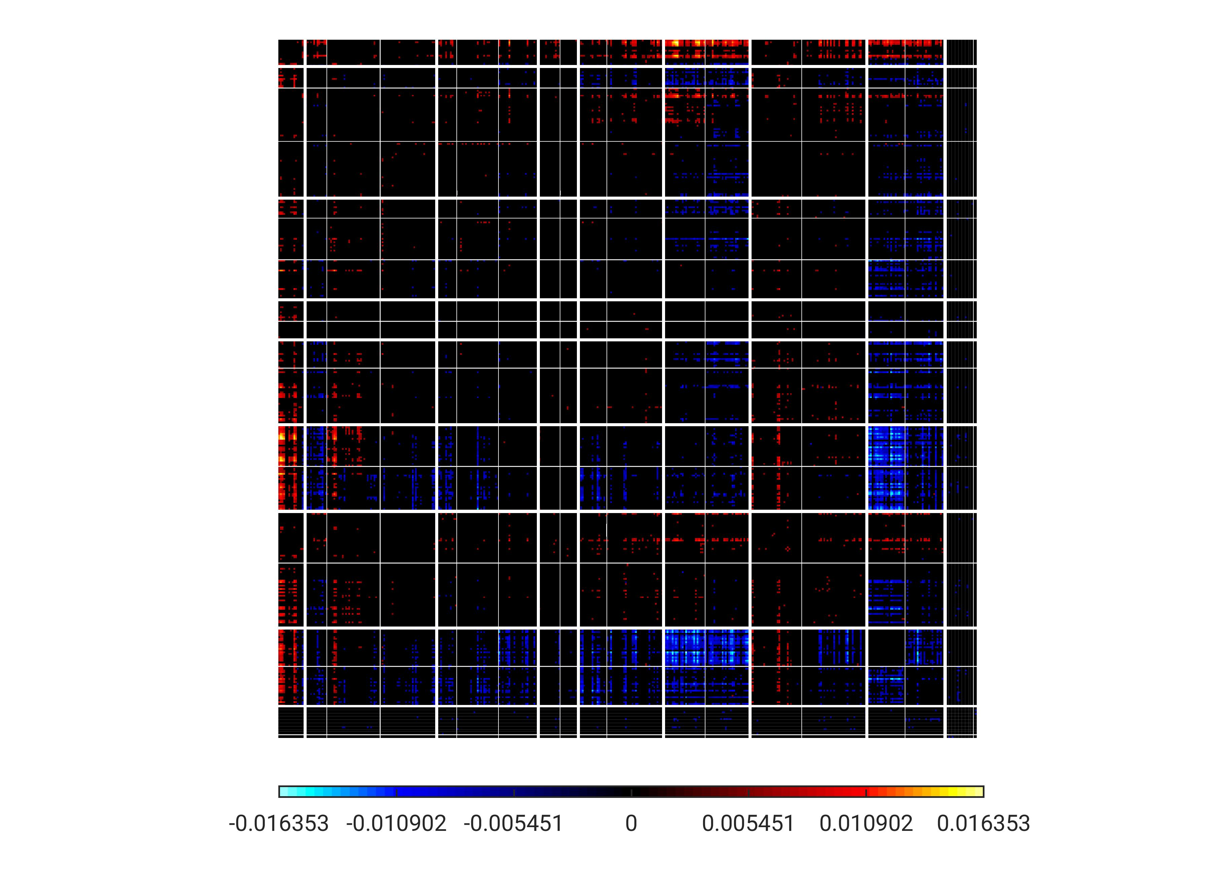
PC1 – thresholded (10%)
TempPar
Default
Control
Limbic
Sal/VentAttn
DorsAttn
SomMot
Visual
Subcort

Slide 15
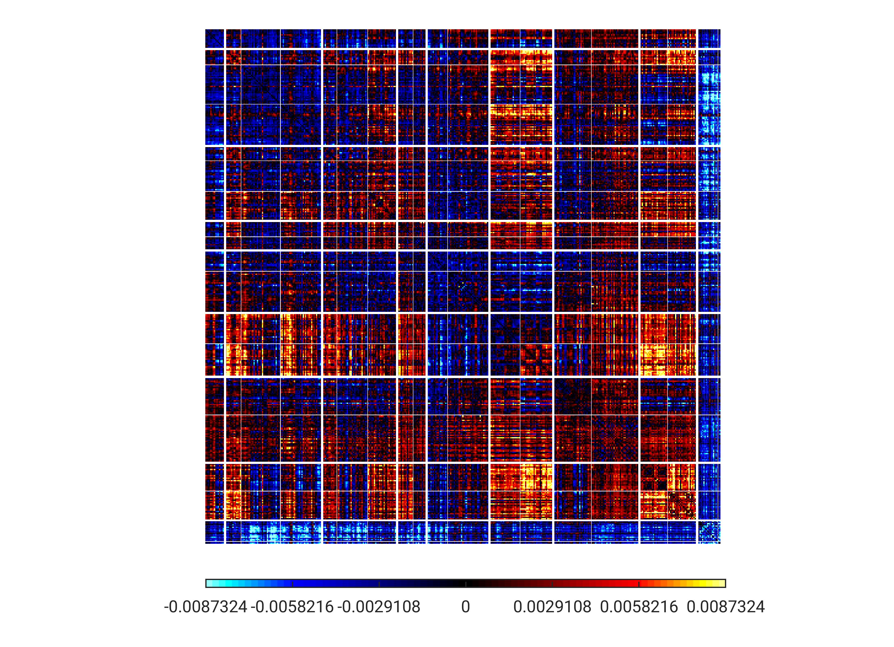
PC2 - unthresholded
TempPar
Default
Control
Limbic
Sal/VentAttn
DorsAttn
SomMot
Visual
Subcort

Slide 16
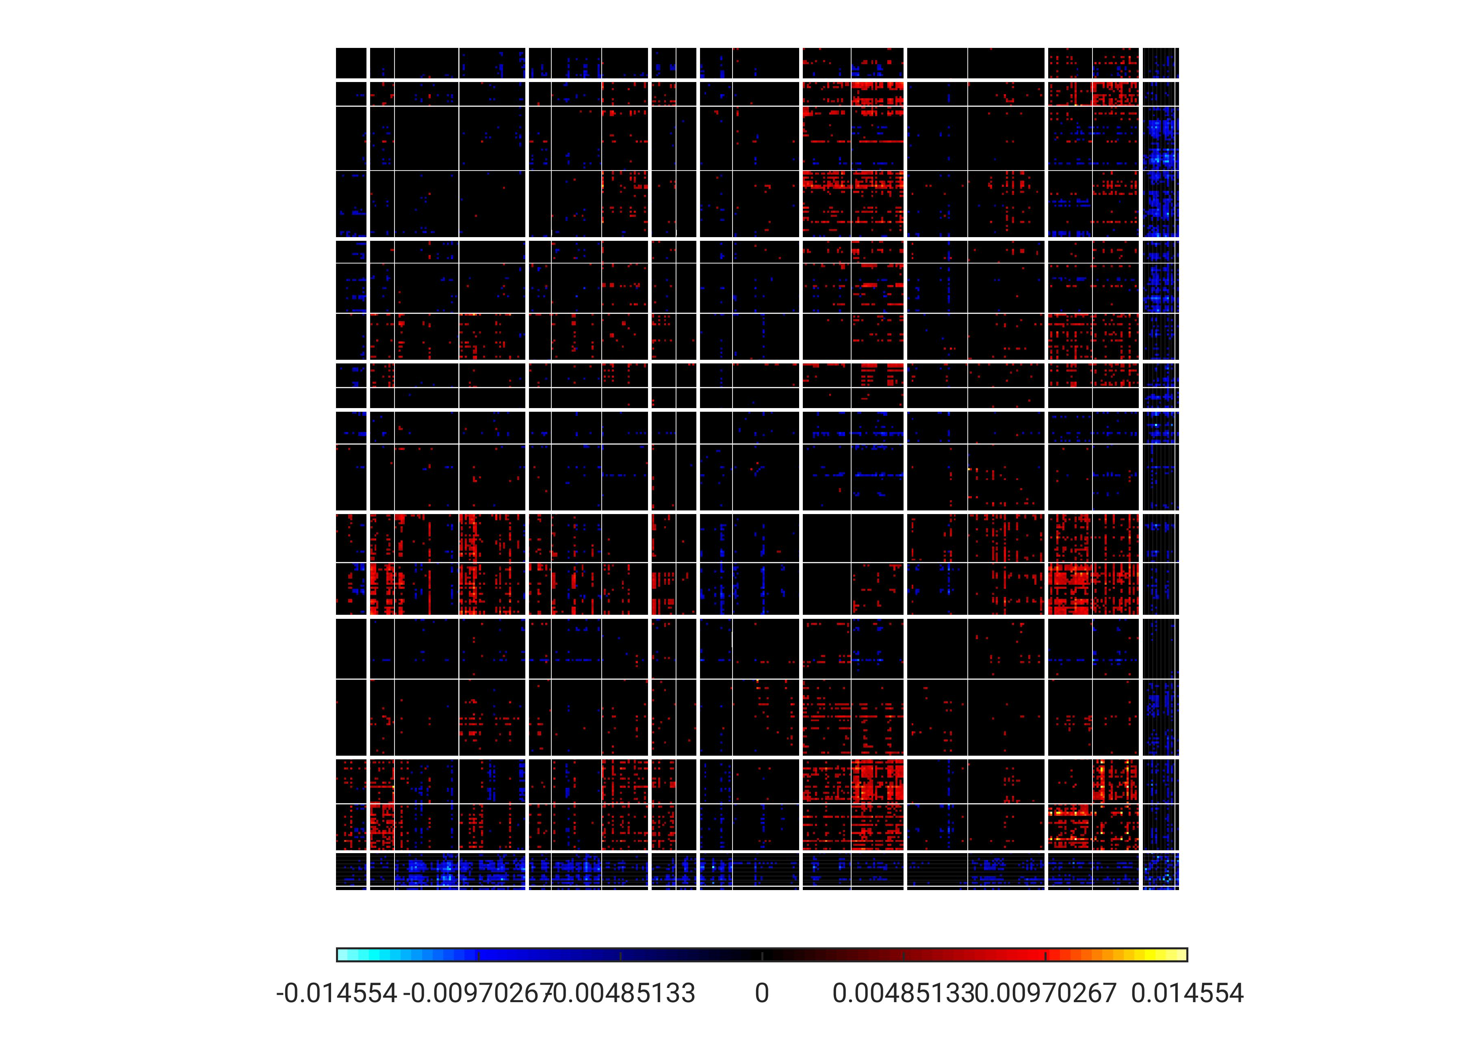
PC2 – thresholded (top 10%)
TempPar
Default
Control
Limbic
Sal/VentAttn
DorsAttn
SomMot
Visual
Subcort

Slide 17
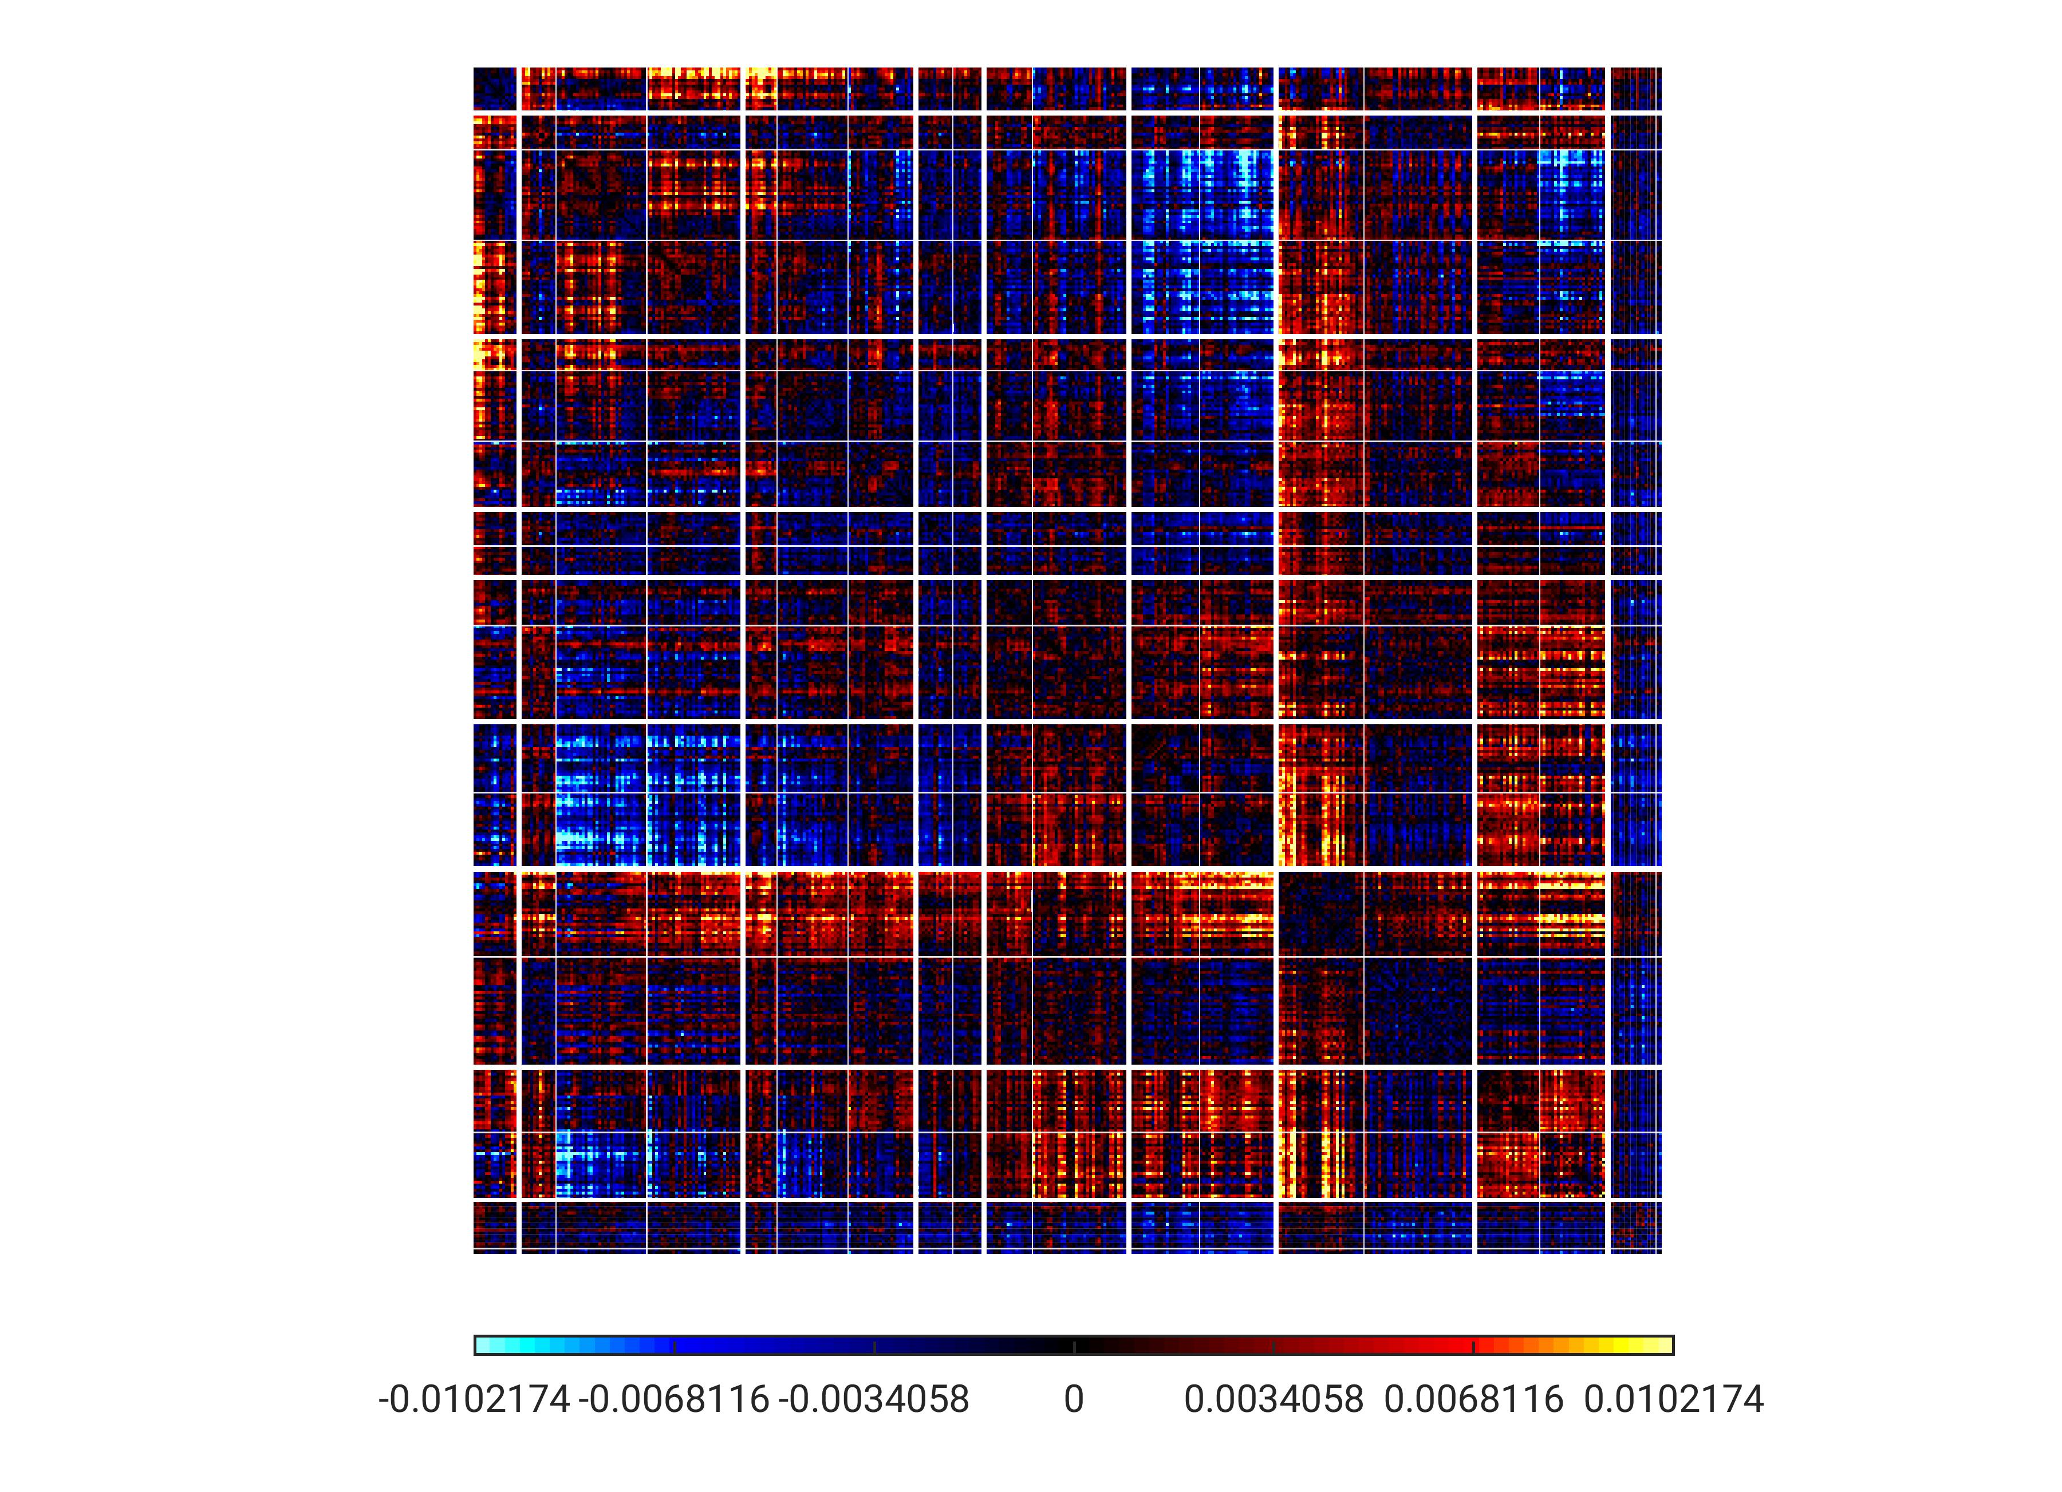
PC3 - unthresholded
TempPar
Default
Control
Limbic
Sal/VentAttn
DorsAttn
SomMot
Visual
Subcort

Slide 18
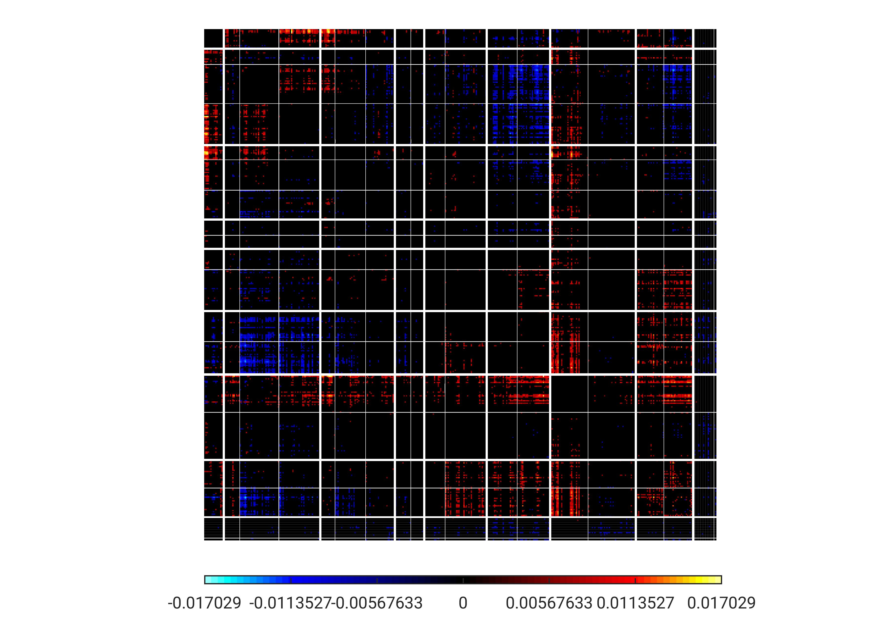
PC3 – thresholded (top 10%)
TempPar
Default
Control
Limbic
Sal/VentAttn
DorsAttn
SomMot
Visual
Subcort

Slide 19
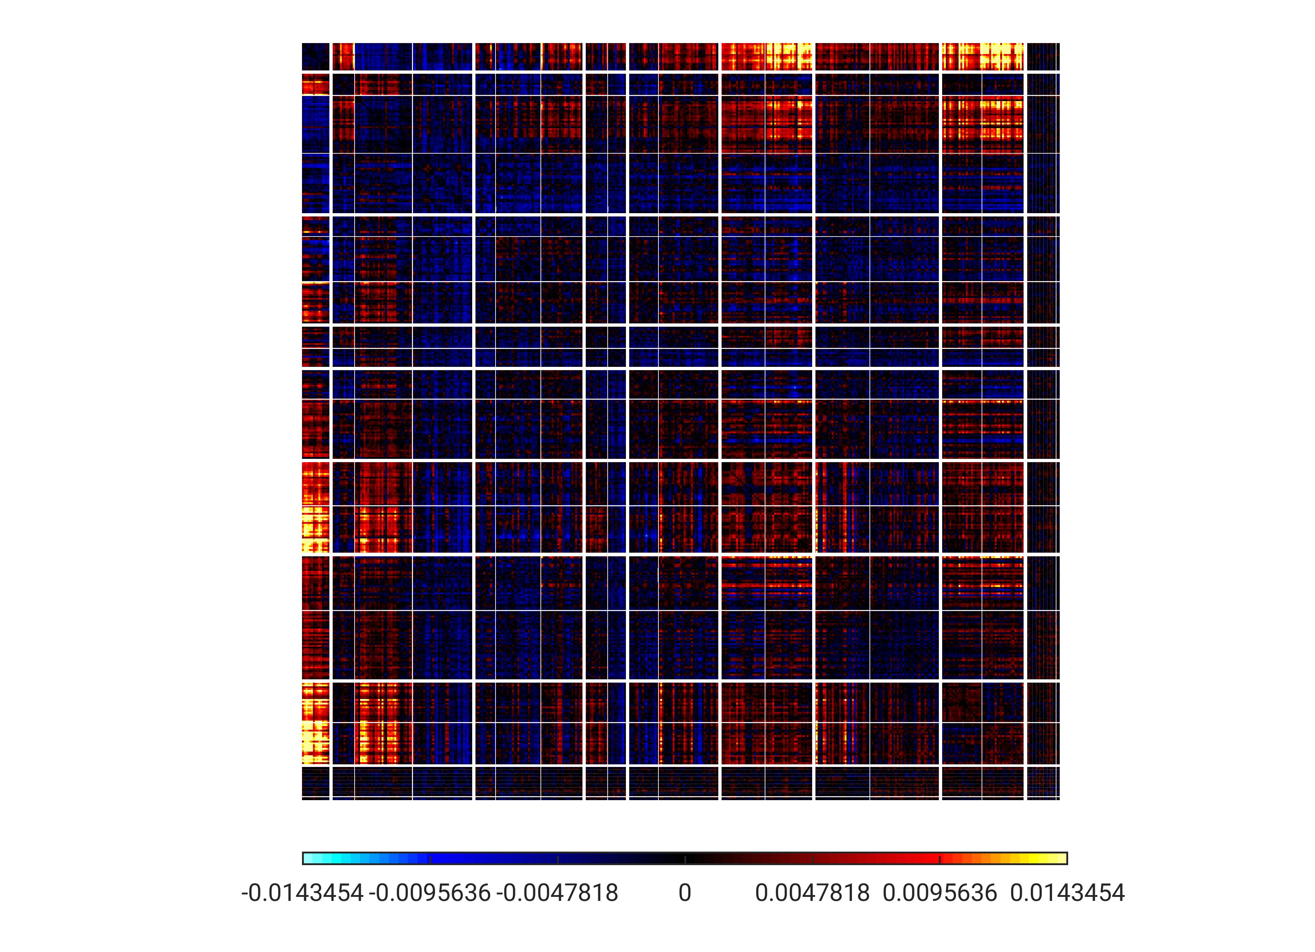
PC4 – unthresholded
TempPar
Default
Control
Limbic
Sal/VentAttn
DorsAttn
SomMot
Visual
Subcort

Slide 20
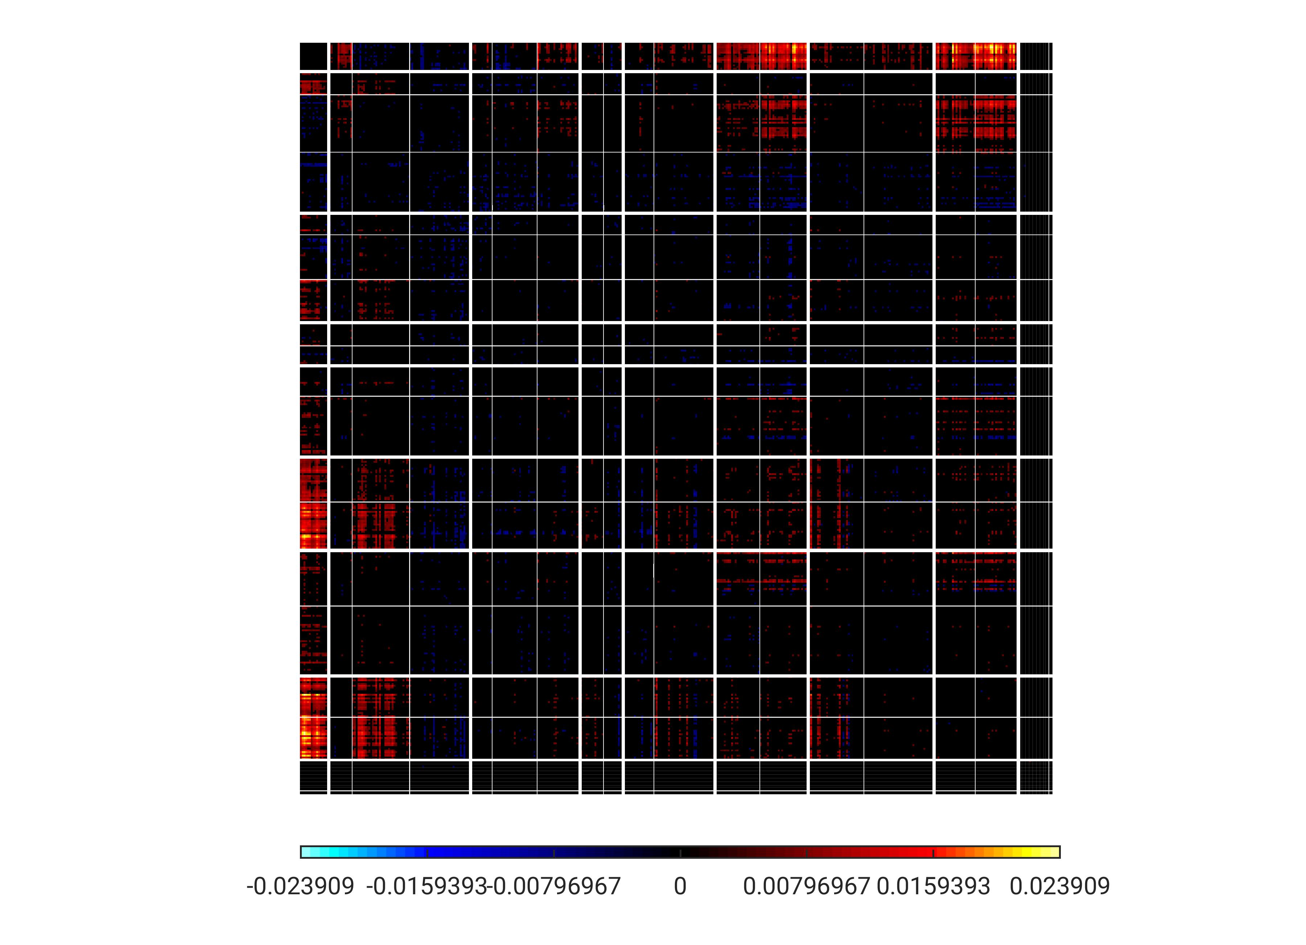
PC4 – thresholded (top 10%)
TempPar
Default
Control
Limbic
Sal/VentAttn
DorsAttn
SomMot
Visual
Subcort

Slide 21
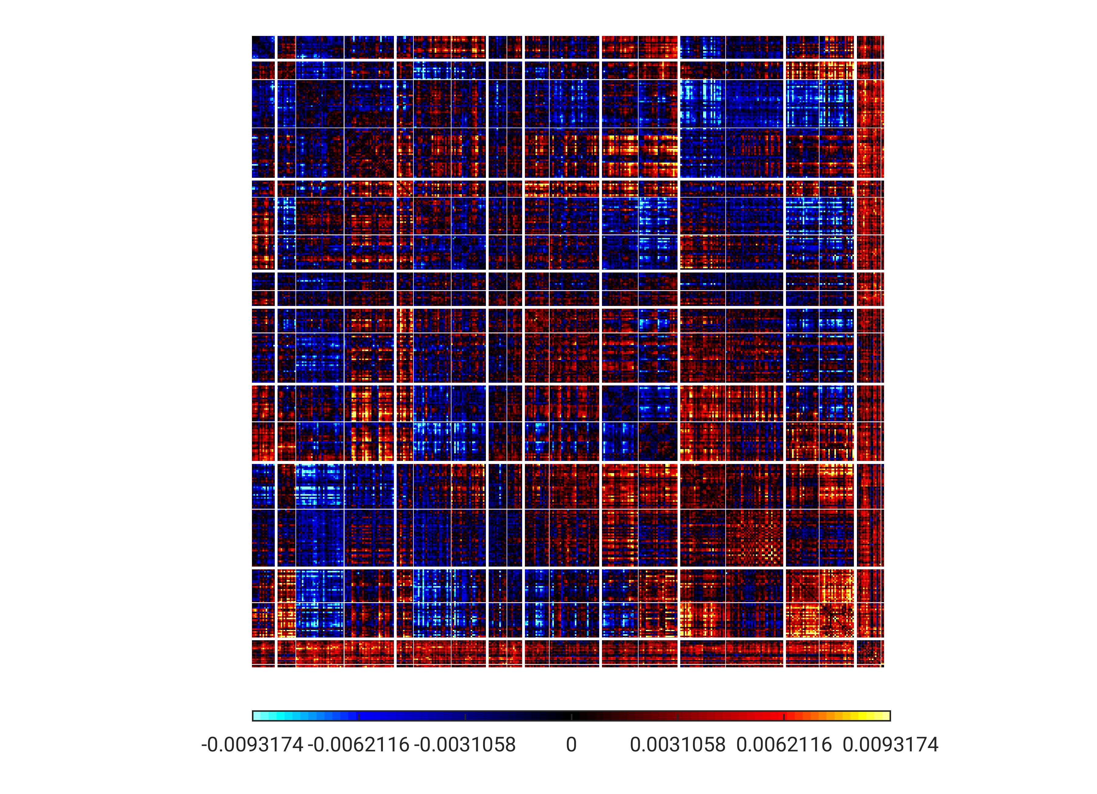
PC5 - unthresholded
TempPar
Default
Control
Limbic
Sal/VentAttn
DorsAttn
SomMot
Visual
Subcort

Slide 22
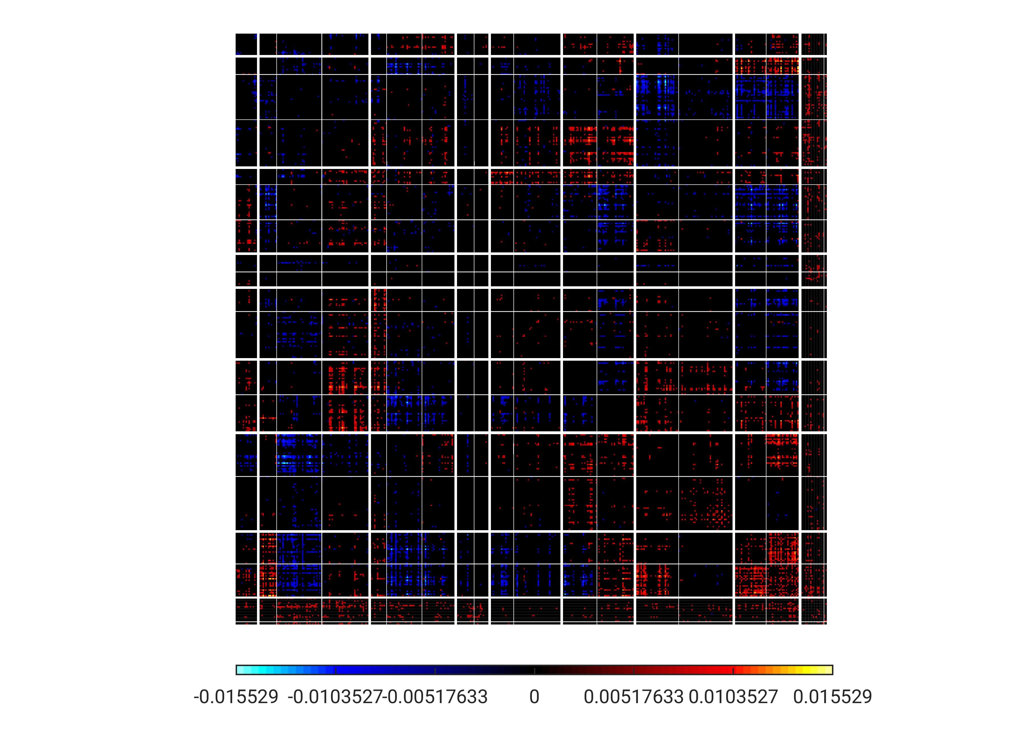
PC5 – thresholded (top 10%)
TempPar
Default
Control
Limbic
Sal/VentAttn
DorsAttn
SomMot
Visual
Subcort

Slide 23
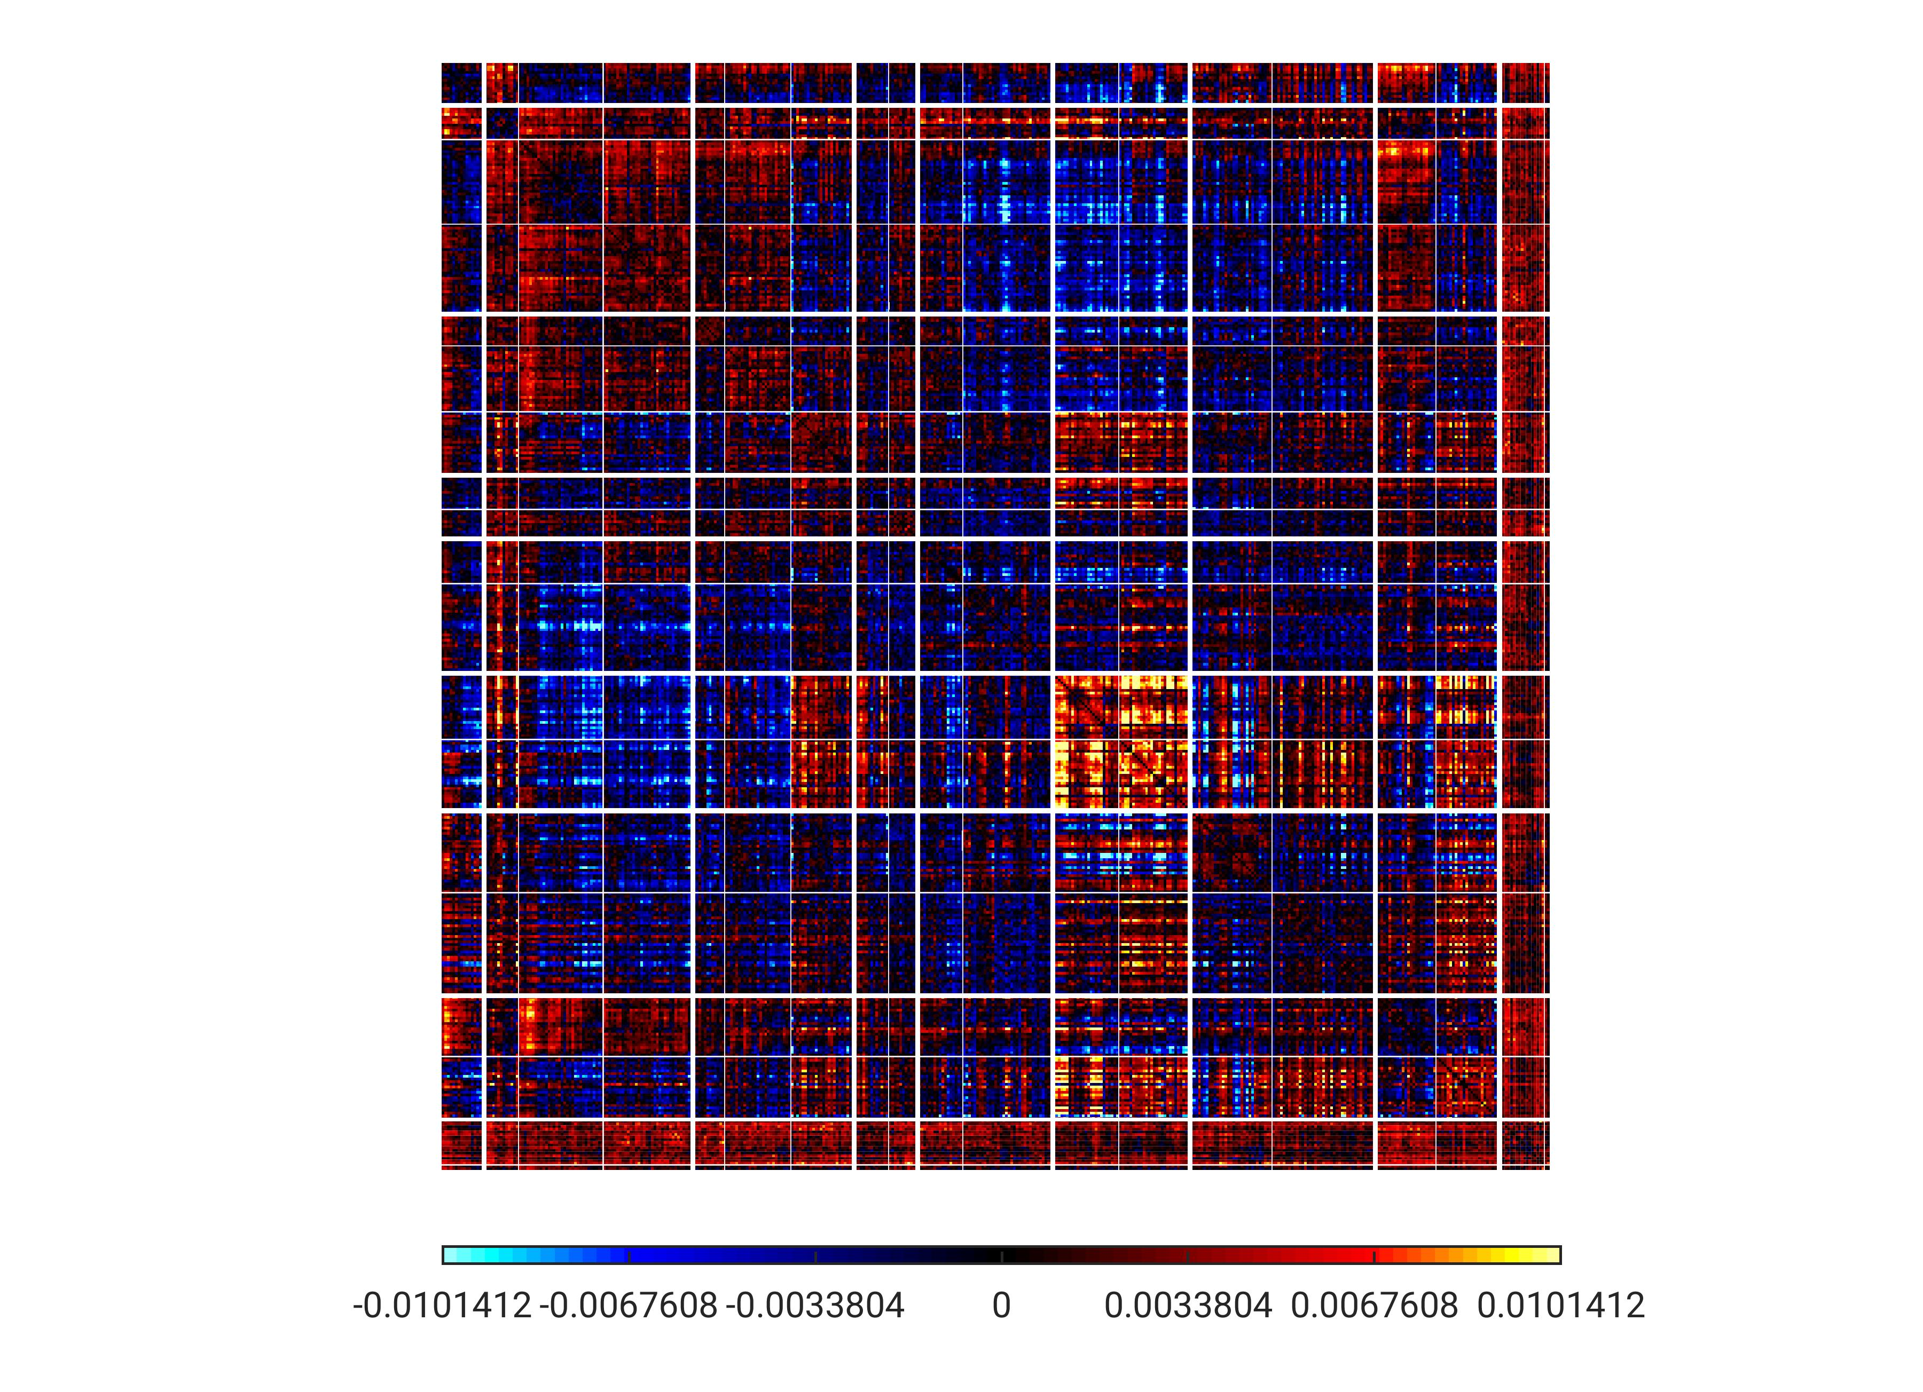
PC6 - unthresholded
TempPar
Default
Control
Limbic
Sal/VentAttn
DorsAttn
SomMot
Visual
Subcort

Slide 24
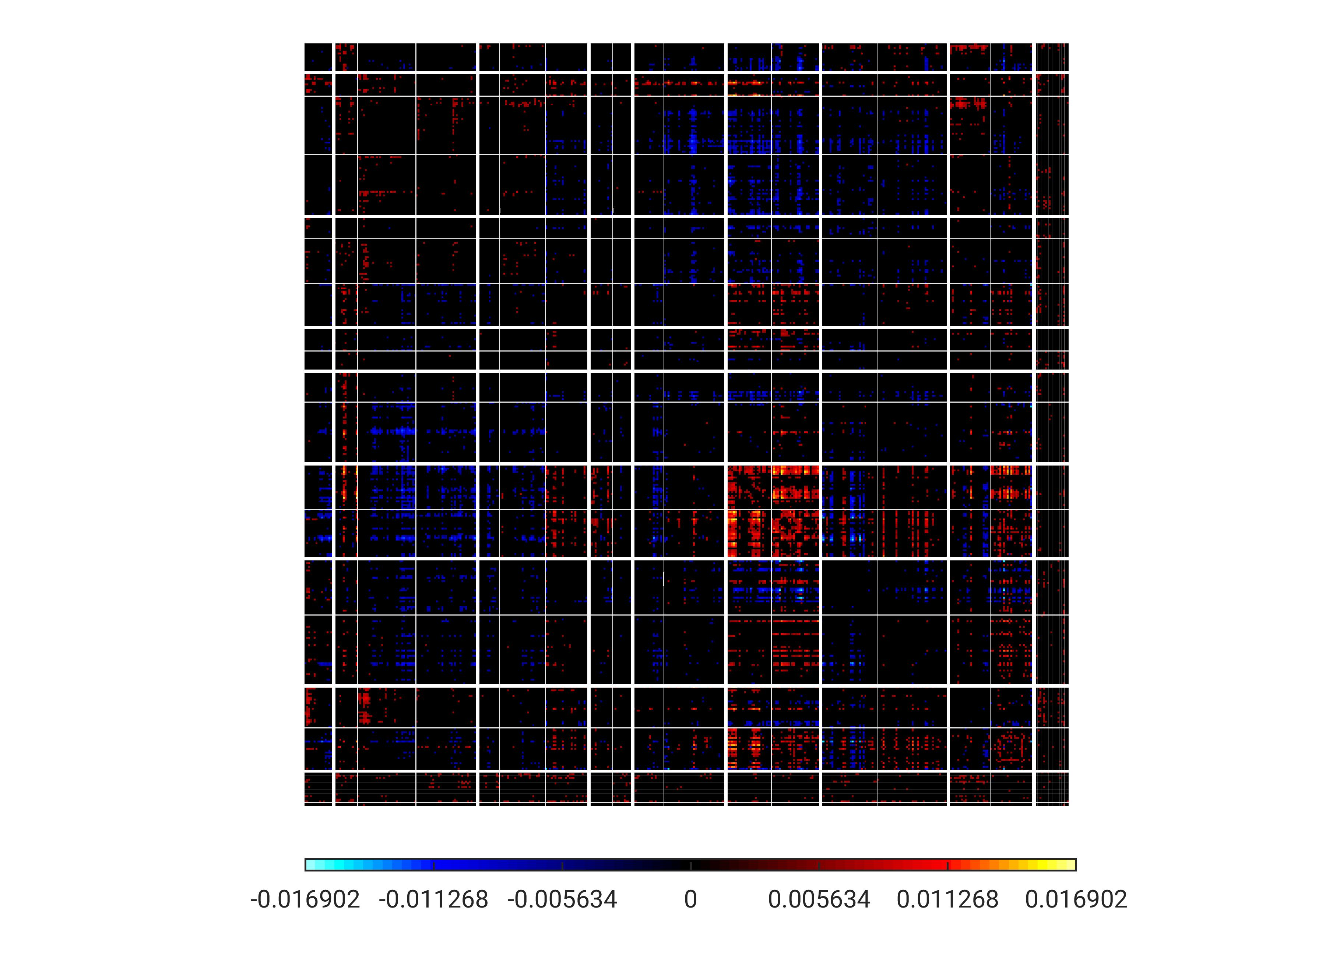
PC6 – thresholded (top 10%)
TempPar
Default
Control
Limbic
Sal/VentAttn
DorsAttn
SomMot
Visual
Subcort

Slide 25
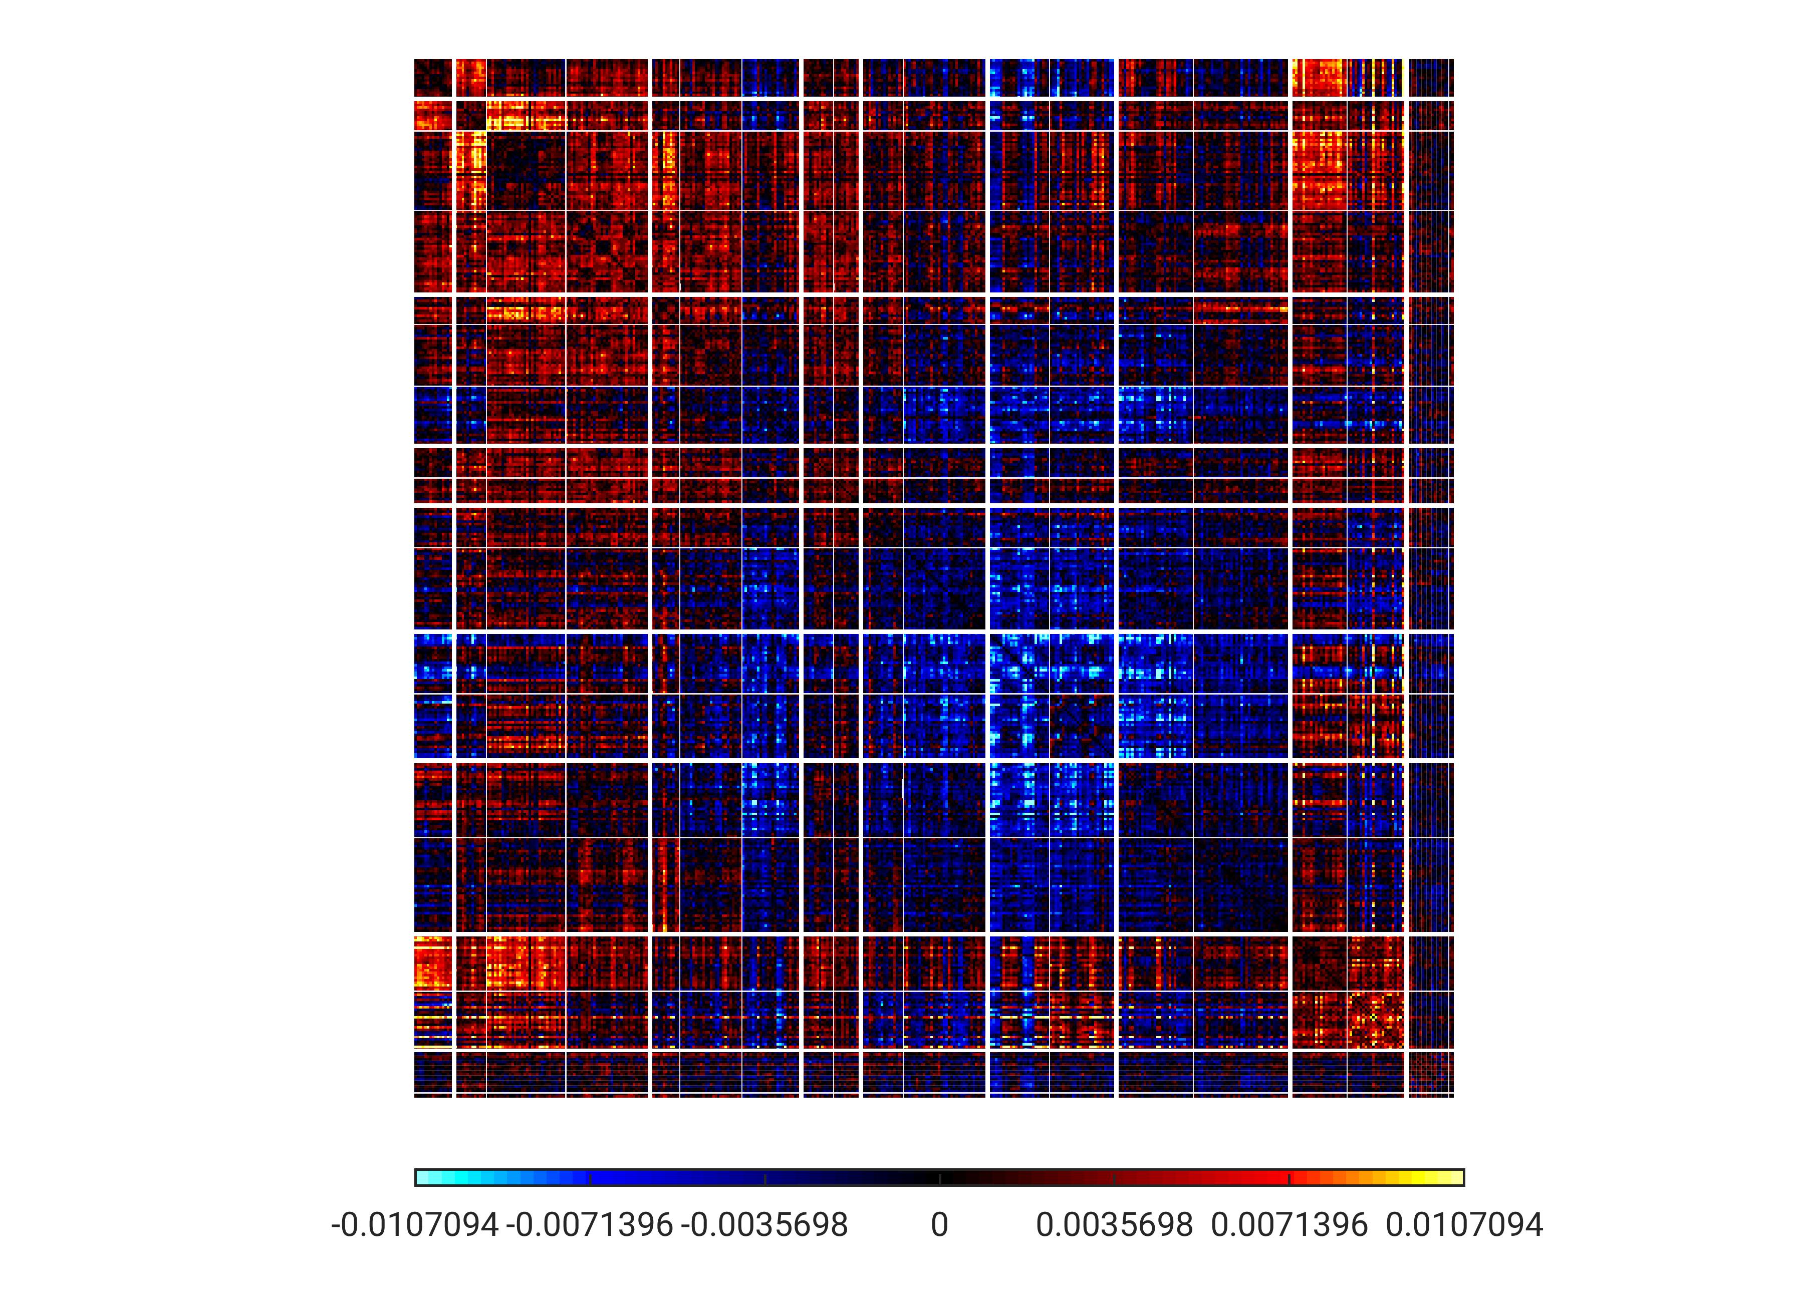
PC7 - unthresholded
TempPar
Default
Control
Limbic
Sal/VentAttn
DorsAttn
SomMot
Visual
Subcort

Slide 26
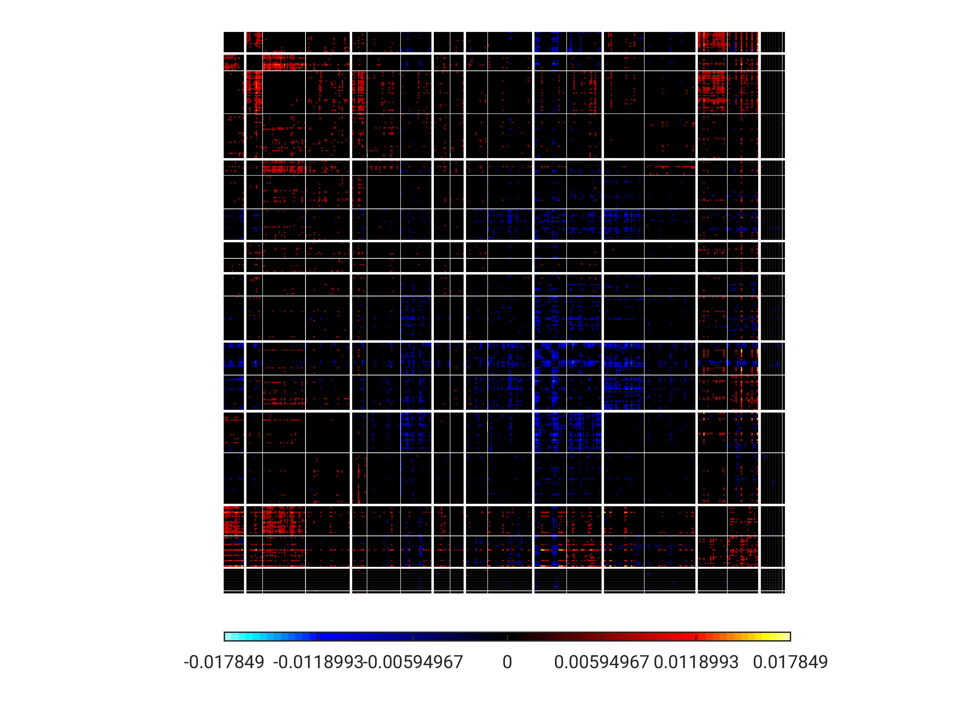
PC7 – thresholded (top 10%)
TempPar
Default
Control
Limbic
Sal/VentAttn
DorsAttn
SomMot
Visual
Subcort

Slide 27
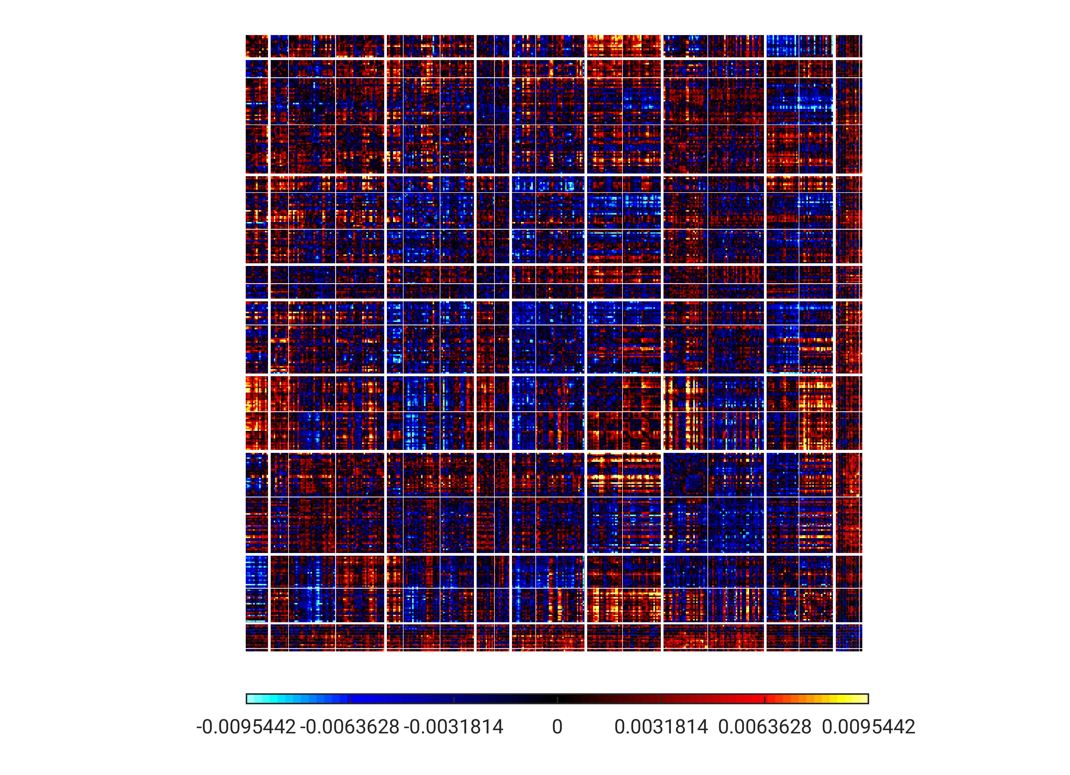
PC8 - unthresholded
TempPar
Default
Control
Limbic
Sal/VentAttn
DorsAttn
SomMot
Visual
Subcort

Slide 28
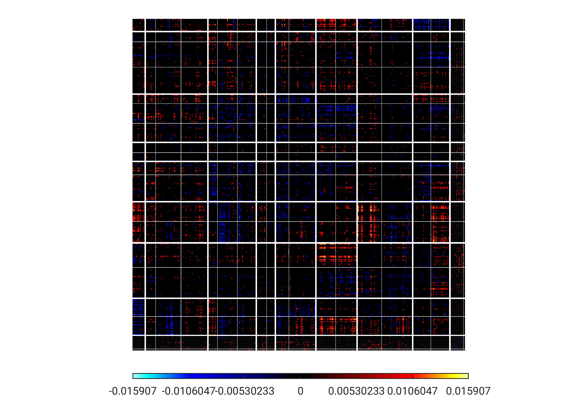
PC8 – thresholded (top 10%)
TempPar
Default
Control
Limbic
Sal/VentAttn
DorsAttn
SomMot
Visual
Subcort

Slide 29
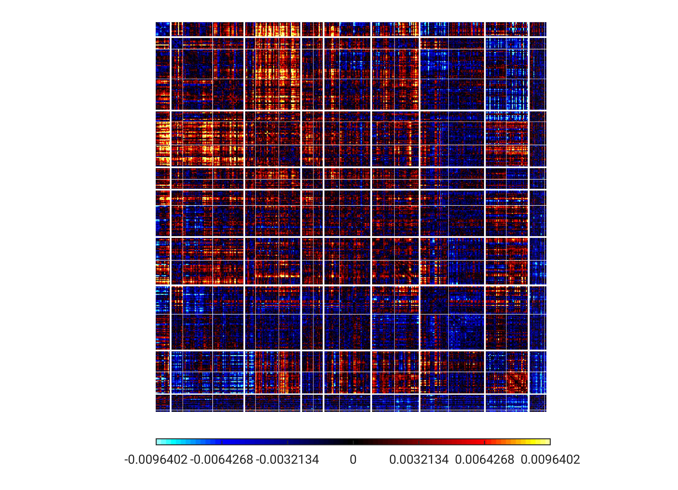
PC9 - unthresholded
TempPar
Default
Control
Limbic
Sal/VentAttn
DorsAttn
SomMot
Visual
Subcort

Slide 30
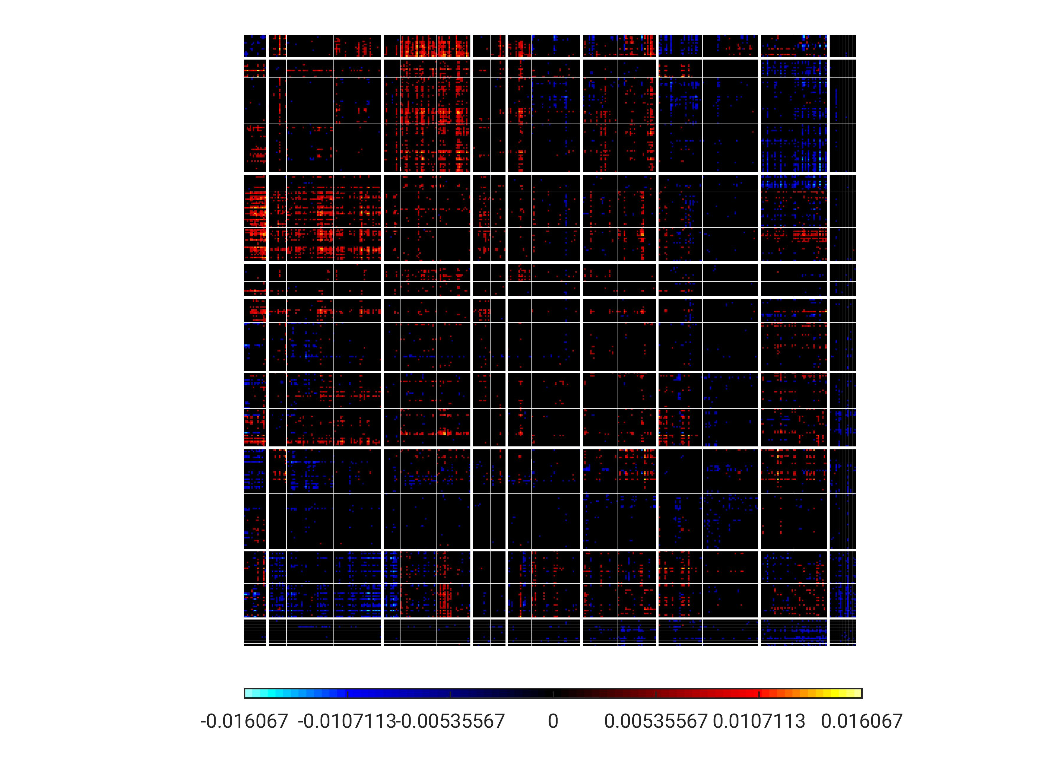
PC9 – thresholded (top 10%)
TempPar
Default
Control
Limbic
Sal/VentAttn
DorsAttn
SomMot
Visual
Subcort

Slide 31
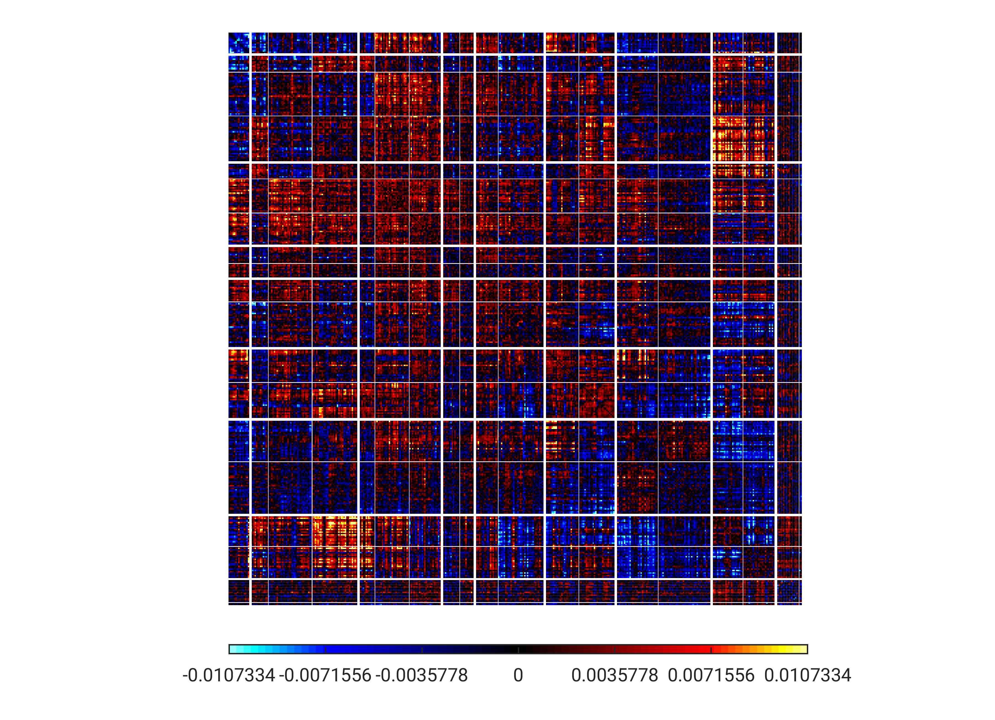
PC10 - unthresholded
TempPar
Default
Control
Limbic
Sal/VentAttn
DorsAttn
SomMot
Visual
Subcort

Slide 32
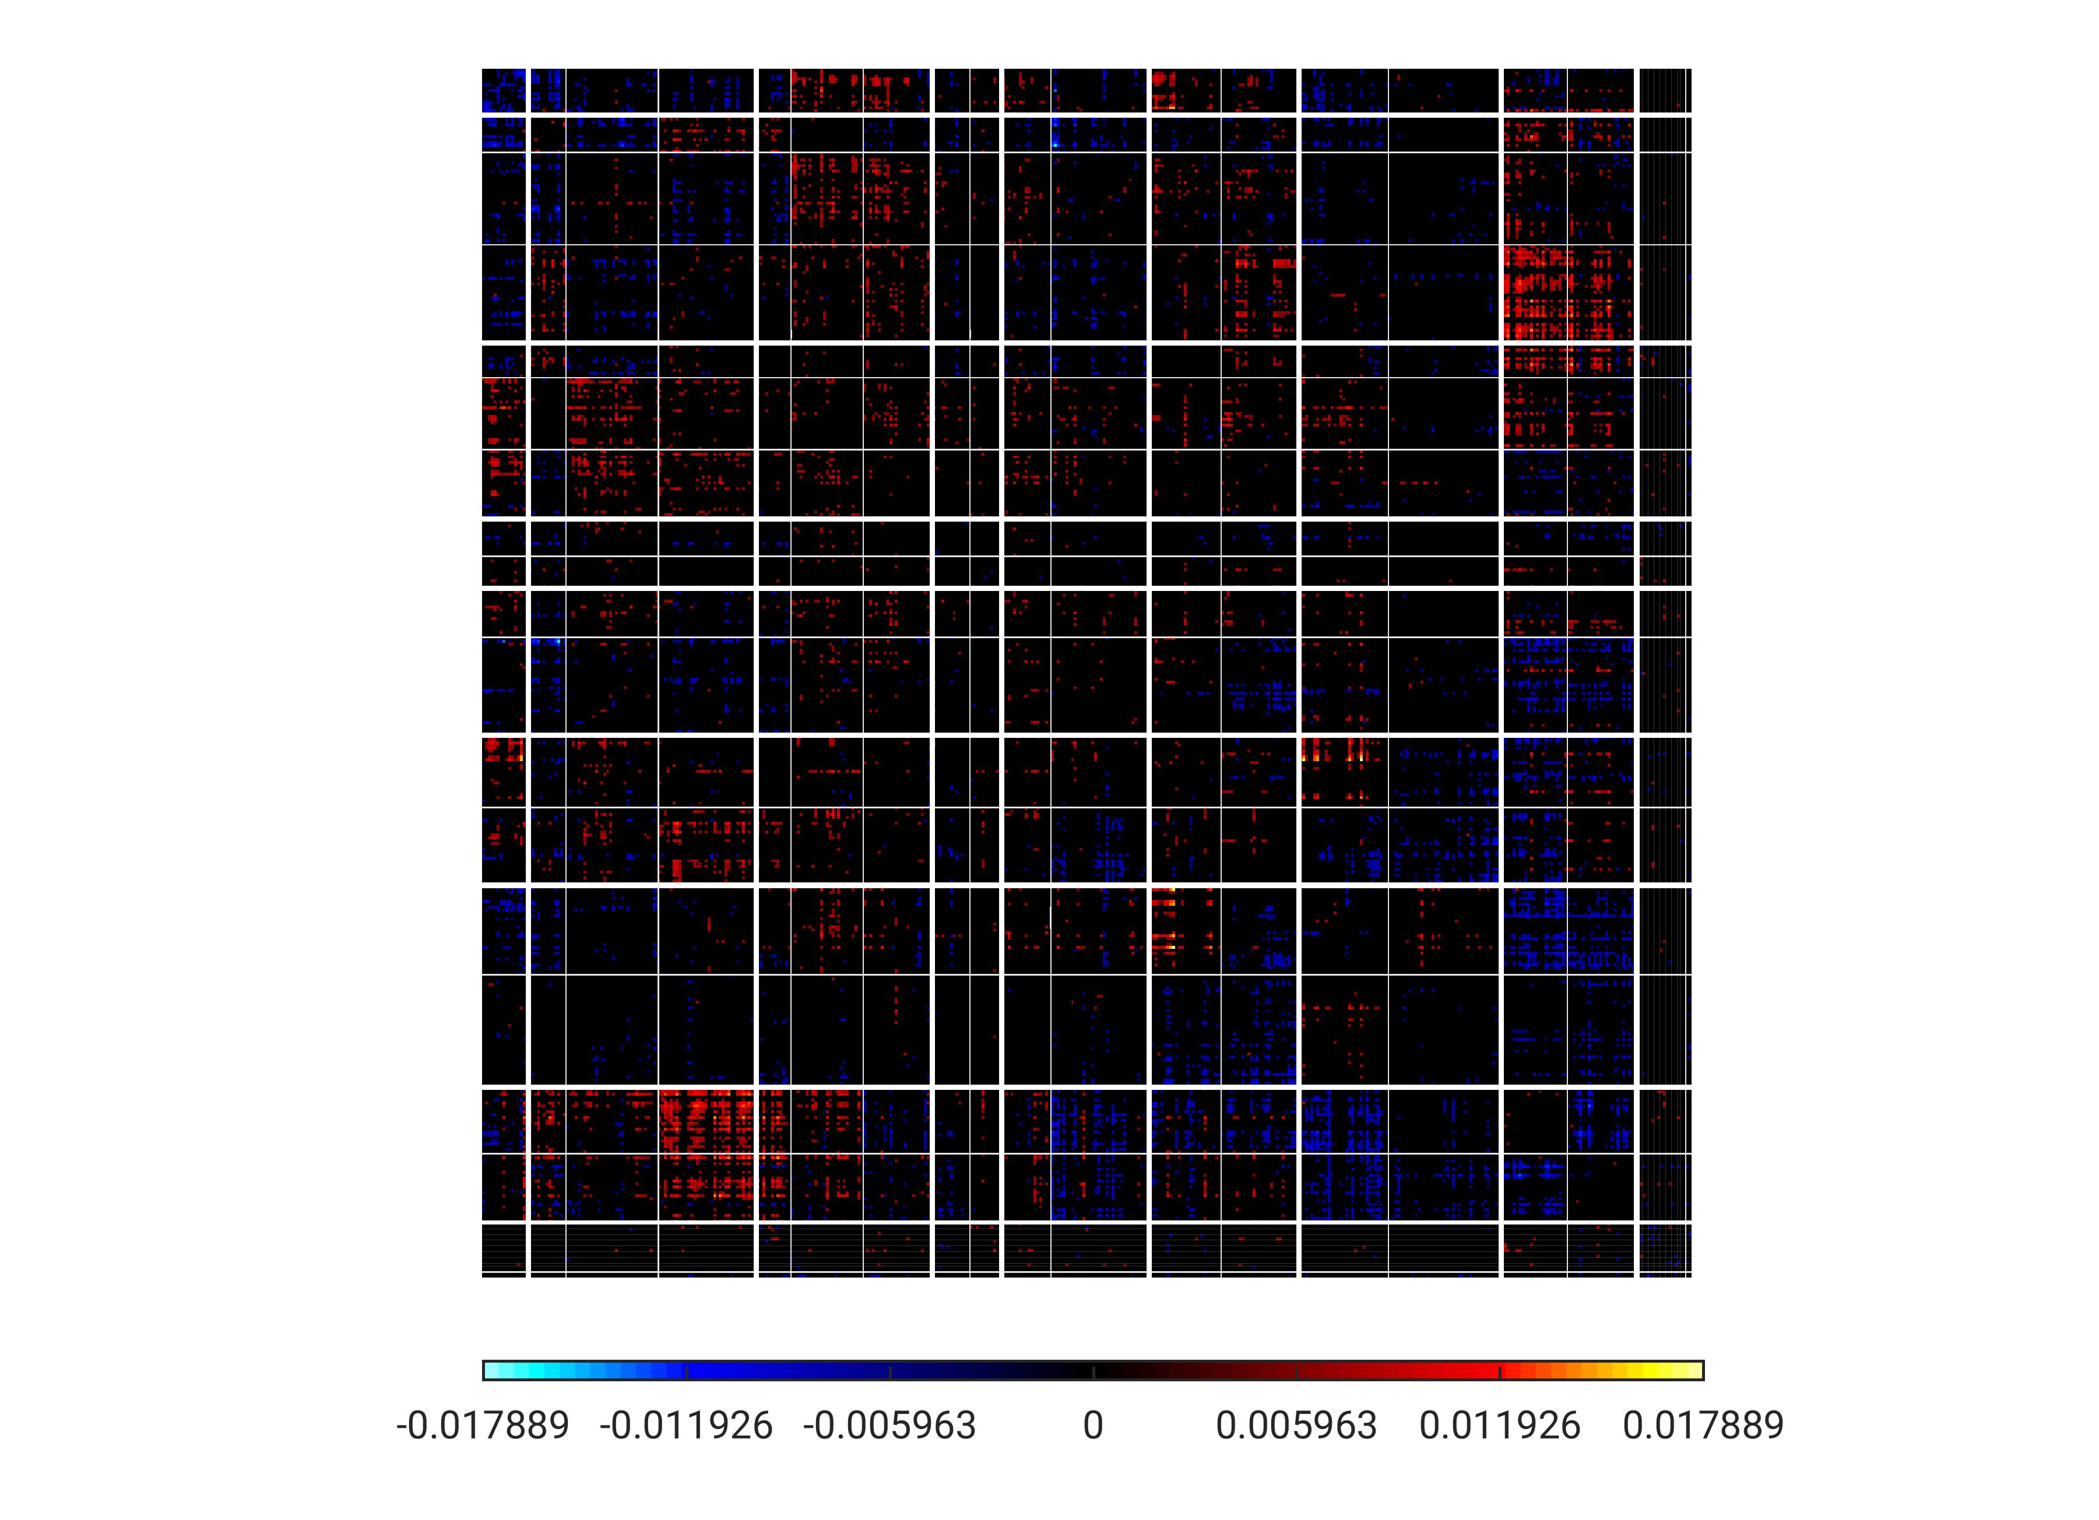
PC10 – thresholded (top 10%)
TempPar
Default
Control
Limbic
Sal/VentAttn
DorsAttn
SomMot
Visual
Subcort

Slide 33
Summary
It would seem that connectivity between brain regions tend to be better in capturing information of the movie scene being viewed, rather than just the pattern of activity.
The PC plots show that the connections between the Visual network and other networks, not just within the Visual network, tend to be more important in representing movie scenes.

